Slide 1
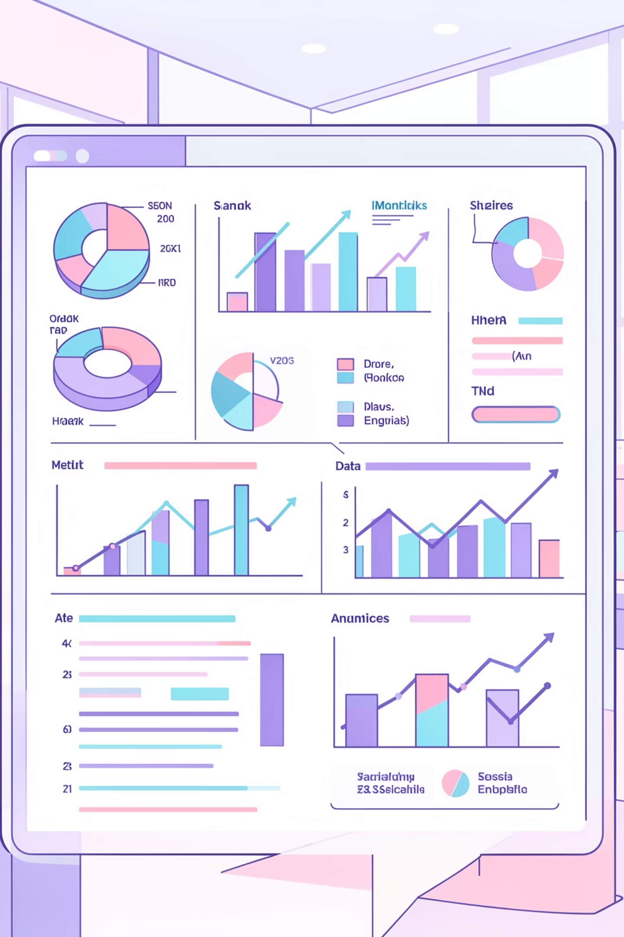
Customer Shopping Behavior Analysis
Uncovering insights from 3,900 purchases to guide strategic business decisions

Slide 2
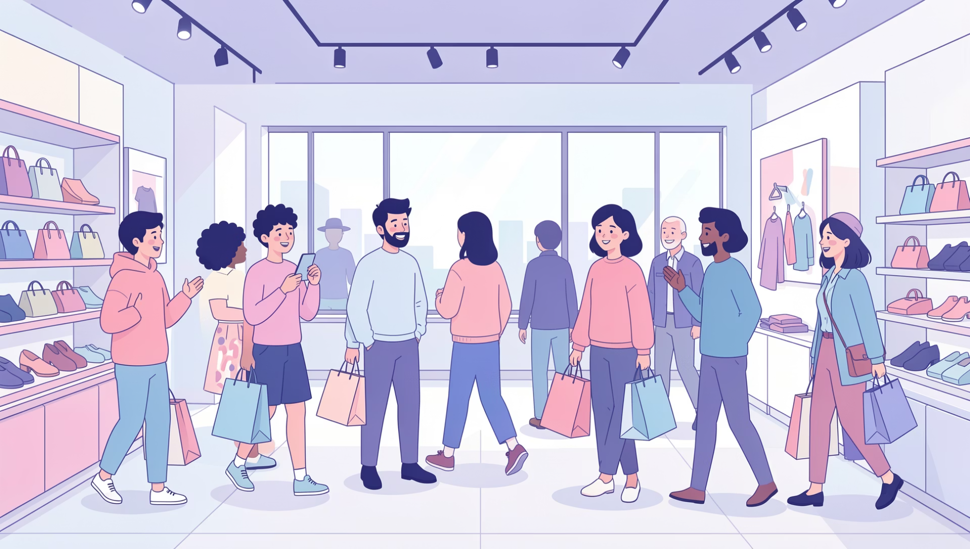
PROJECT SCOPE
Dataset at a Glance
3.9K
18
4
Total Purchases
Data Points
Categories
Transactions analyzed
Features per transaction
Product segments tracked
Key Data Features
Customer demographics and location
Purchase details and pricing
Shopping behavior patterns
Subscription and loyalty metrics

Slide 3


PYTHON ANALYSIS
Data Preparation Pipeline
01
Data Loading & Exploration
Imported dataset, checked structure and summary statistics
02
Cleaning & Standardization
Handled 37 missing values, renamed columns to snake_case
03
Feature Engineering
Created age_group and purchase_frequency_days columns
04
Database Integration
Connected to PostgreSQL for advanced SQL analysis

Slide 4
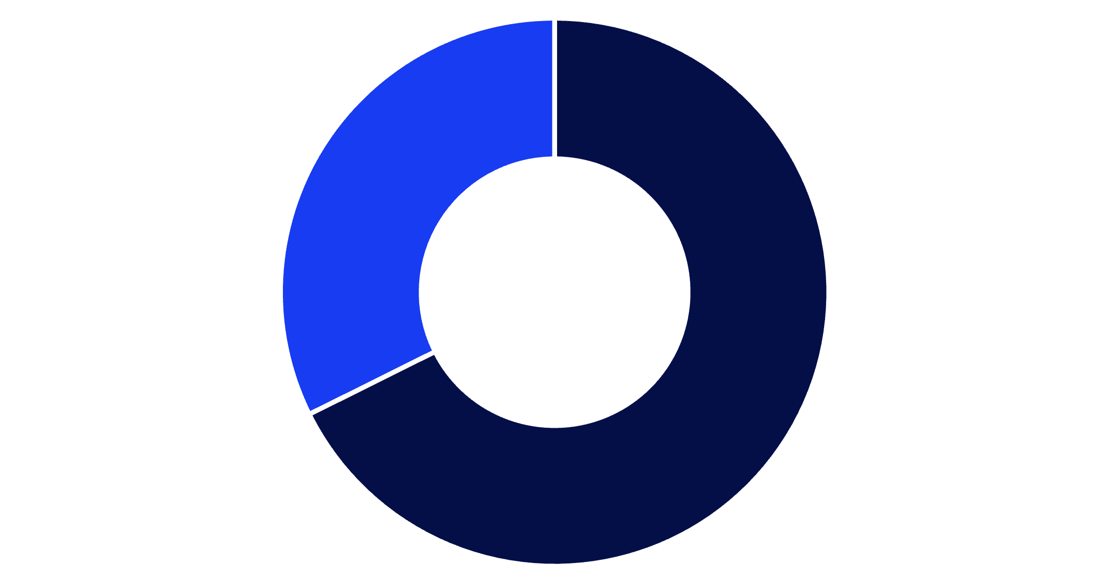
SQL INSIGHTS
Revenue by Gender
Male Customers Drive Revenue
Male customers generate $157,890 in total revenue, more than double female customers at $75,191.
This represents a significant opportunity for targeted marketing strategies.
Male
Female

Slide 5
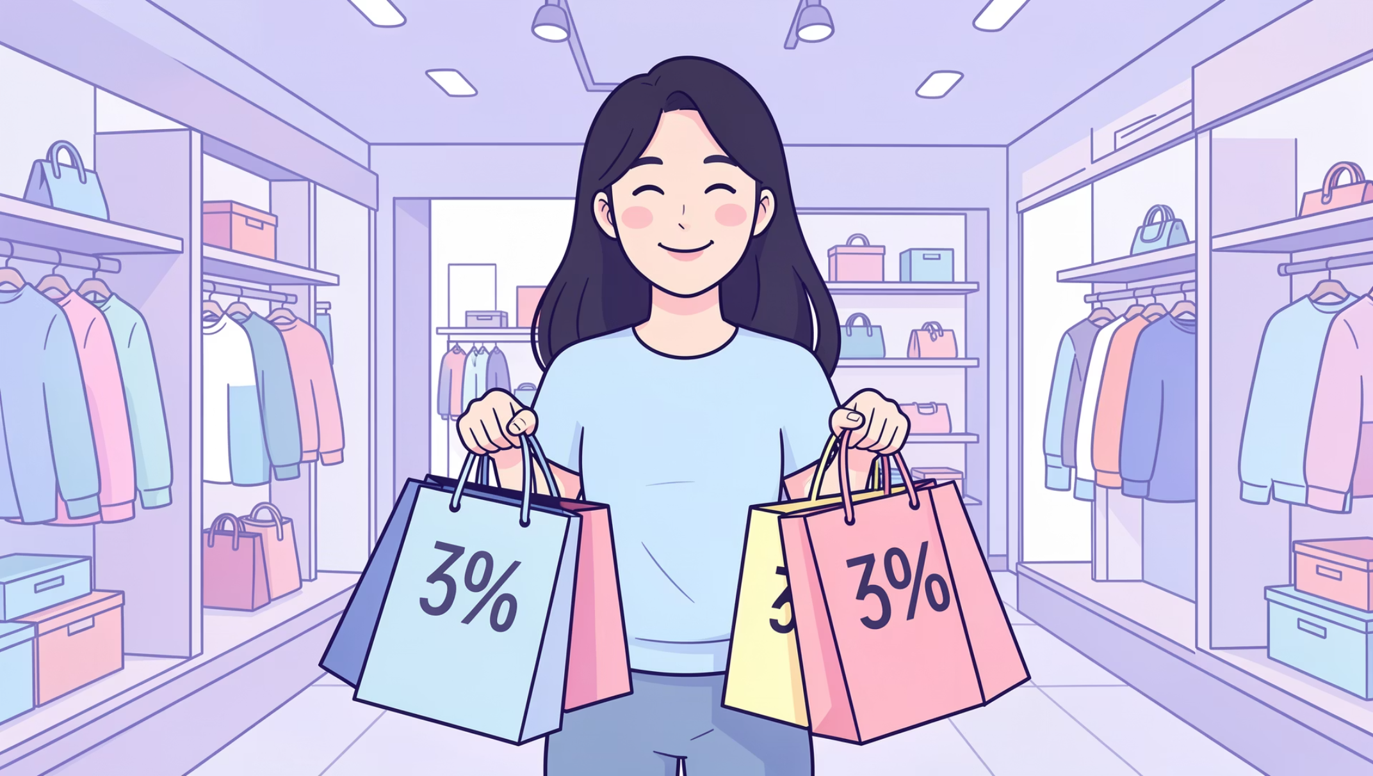
Smart Discount Users
High-Value Discount Shoppers
839 customers used discounts but still spent above average purchase amount.
These savvy shoppers balance value-seeking with premium purchases—ideal targets for loyalty programs.
Discount Applied
Above Average
Yet high spenders
Purchase amounts

Slide 6




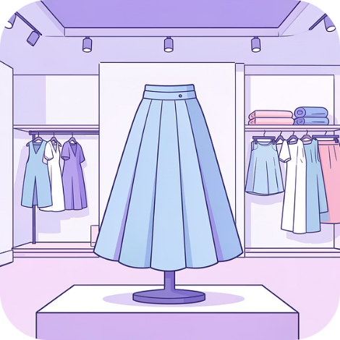
Top-Rated Products
Gloves
Sandals
Boots
Hat
3.86 rating
3.84 rating
3.82 rating
3.80 rating
Skirt
3.78 rating
Highlight these customer favorites in marketing campaigns to drive conversions

Slide 7
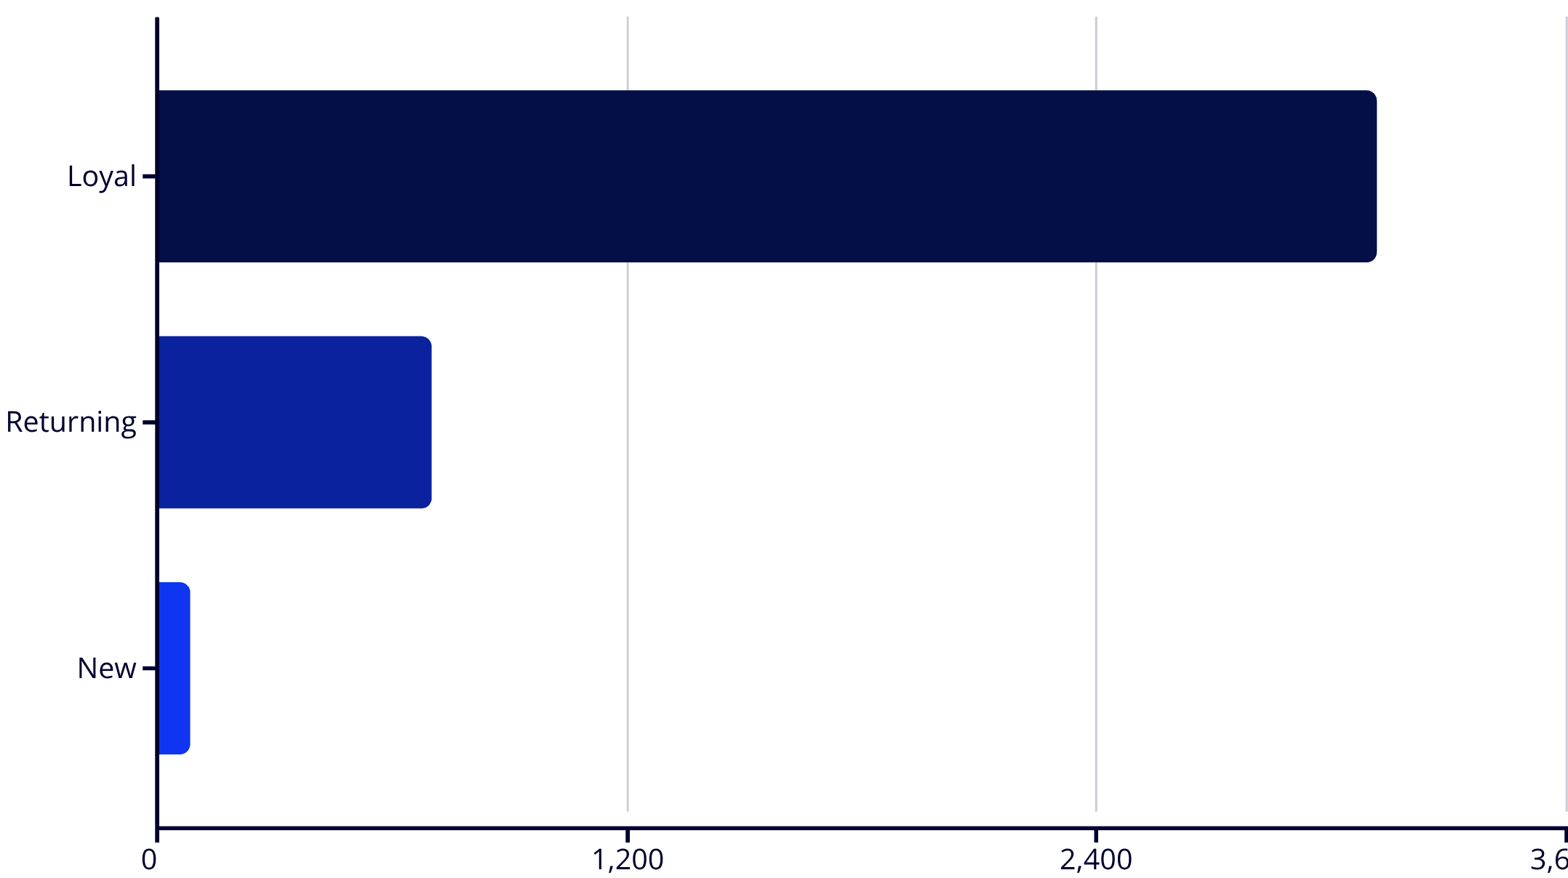

Customer Segmentation Breakdown
Loyalty Dominates
80% of customers are loyal repeat buyers
Focus on moving returning customers into loyal segment through targeted rewards and engagement
Only 83 new customers—acquisition opportunity exists

Slide 8
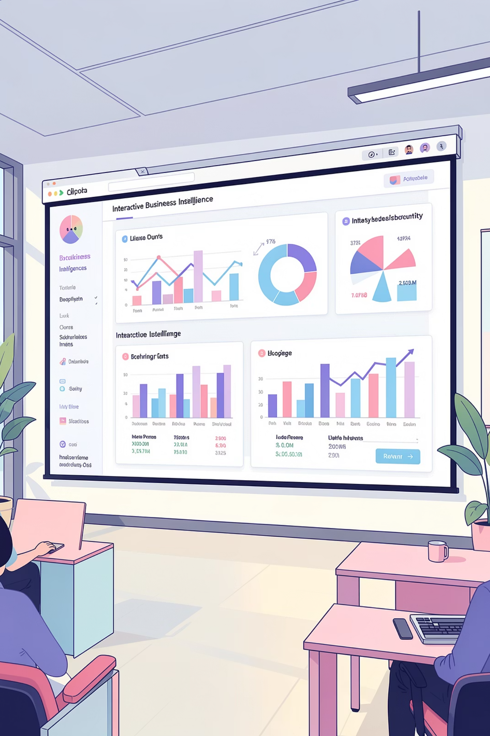
Power BI Dashboard Insights
Clothing Leads
Accessories Strong
Young Adults Top
$100K revenue, 1,800 sales
$70K revenue, 1,200 sales
$45K revenue generated
27% Subscribe
Subscription adoption rate

Slide 9
STRATEGIC ACTIONS
Business Recommendations
Boost Subscriptions
1
Promote exclusive benefits to increase 27% subscription rate
Loyalty Programs
2
Reward repeat buyers to grow loyal customer segment
Review Discounts
3
Balance sales growth with margin control strategies
Product Positioning
4
Highlight top-rated items in marketing campaigns
Targeted Marketing
5
Focus on high-revenue age groups and express shipping users

Slide 10

Key Takeaways
Data-Driven Decisions
Loyalty is Gold
3,900 transactions reveal clear patterns in customer behavior and preferences
80% loyal customers provide stable revenue foundation for growth
Strategic Opportunities
Subscription growth and targeted marketing offer immediate ROI potential

